Slide 1
MAT 350 Engineering mathematics
System of Linear ODEs: 2nd lecture
NONHOMOGENEOUS LINEAR SYSTEMS
Lecture: 12
Dr. M. Sahadet Hossain (Mth)
Associate Professor
Department of Mathematics and Physics, NSU.

Slide 2
NONHOMOGENEOUS LINEAR SYSTEMS
The general solution of a nonhomogeneous linear
system
The methods of undetermined coefficient and variation of parameters are used to find the particular solutions of nonhomogeneous linear ODEs. We only focus on of undetermined coefficient.

Slide 3
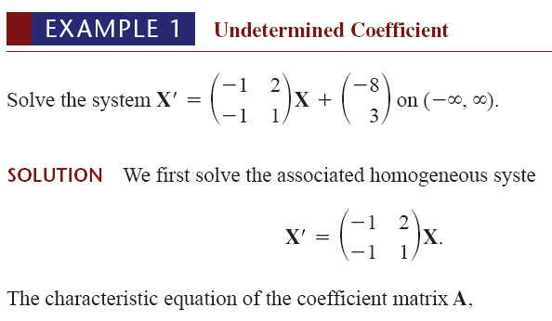

UNDETERMINED COEFFICIENTS

Slide 4



Note that α= 0, and β=1
Now since F(t) is a constant vector, we assume a constant
particular solution vector
Substituting this latter assumption into the original system and equating entries leads to

Slide 5




Slide 6
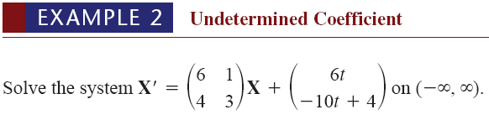
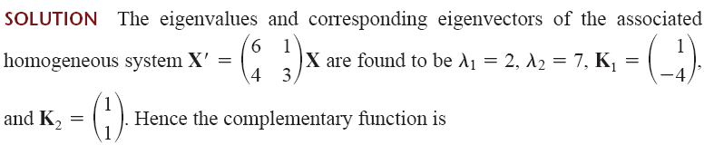





Slide 7
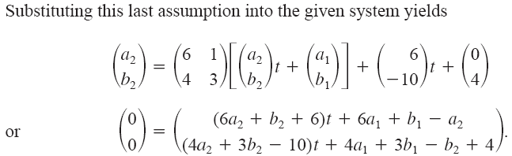
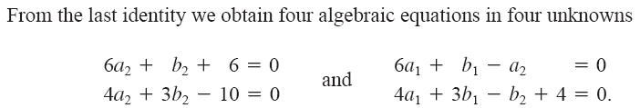

Slide 8

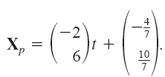
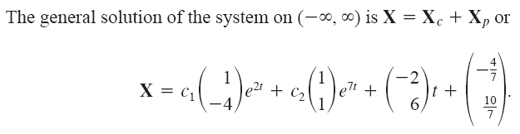


Slide 9

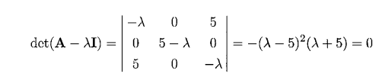




Slide 10




Slide 11
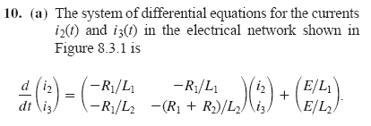
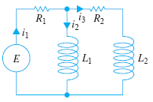


Slide 12
